Slide 1
Lessons From Daniel:
The Biblical Young Professional Example

Slide 2

Dan 1:3 And the king spake unto Ashpenaz the master of his eunuchs, that he should bring certain of the children of Israel, and of the king's seed, and of the princes;
Dan 1:4 Children in whom was no blemish, but well favoured, and skilful in all wisdom, and cunning in knowledge, and understanding science, and such as had ability in them to stand in the king's palace, and whom they might teach the learning and the tongue of the Chaldeans.

Slide 3
Dan 1:5 And the king appointed them a daily provision of the king's meat, and of the wine which he drank: so nourishing them three years, that at the end thereof they might stand before the king.

Slide 4

Dan 1:6 Now among these were of the children of Judah, Daniel, Hananiah, Mishael, and Azariah:
Dan 1:7 Unto whom the prince of the eunuchs gave names: for he gave unto Daniel the name of Belteshazzar; and to Hananiah, of Shadrach; and to Mishael, of Meshach; and to Azariah, of Abednego.

Slide 5
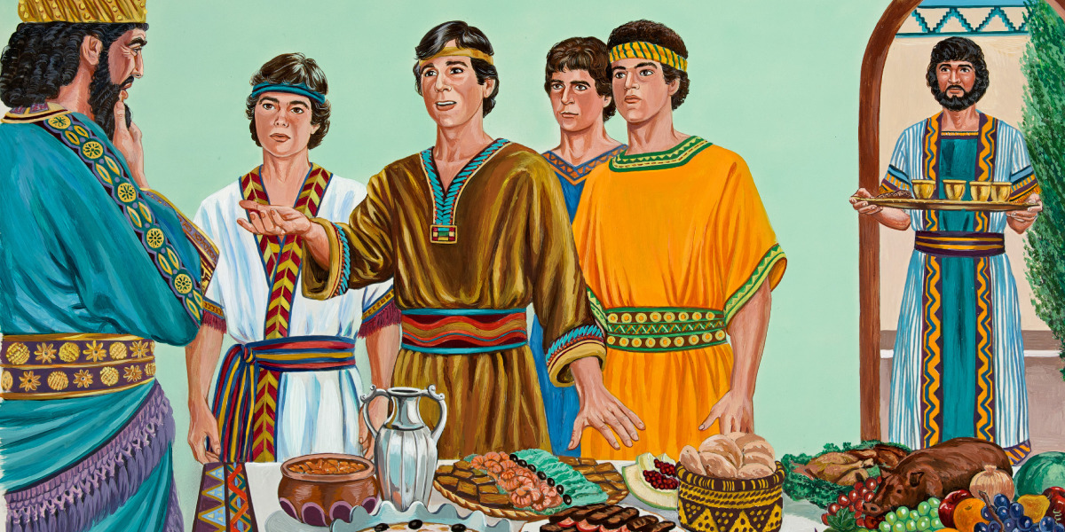

Slide 6
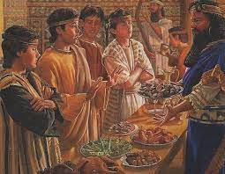

Slide 7
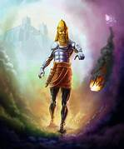

Slide 8
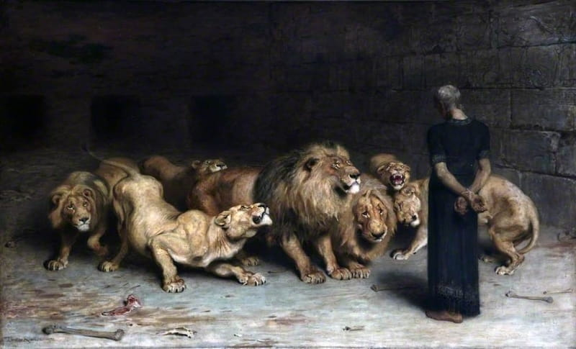

Slide 9
Because of Daniel’s character, he received:
1. Revelation
2. Preservation
3. Exaltation

Slide 10
Dan_5:12 Forasmuch as an excellent spirit, and knowledge, and understanding, interpreting of dreams, and shewing of hard sentences, and dissolving of doubts, were found in the same Daniel, whom the king named Belteshazzar: now let Daniel be called, and he will shew the interpretation.
Dan_6:3 Then this Daniel was preferred above the presidents and princes, because an excellent spirit was in him; and the king thought to set him over the whole realm.

Slide 11
2Ti 2:19 Nevertheless the foundation of God standeth sure, having this seal, The Lord knoweth them that are his. And, Let every one that nameth the name of Christ depart from iniquity.
2Ti 2:20 But in a great house there are not only vessels of gold and of silver, but also of wood and of earth; and some to honour, and some to dishonour.
2Ti 2:21 If a man therefore purge himself from these, he shall be a vessel unto honour, sanctified, and meet for the master's use, and prepared unto every good work.
2Ti 2:22 Flee also youthful lusts: but follow righteousness, faith, charity, peace, with them that call on the Lord out of a pure heart.

Slide 12
Lessons From Daniel:
1.Defining moments of our faith will come in our lives.
2. Crisis will come and everyone prays in times of crisis. But God gives the answer to the man who consecrated.
3. God can use a crisis to promote the faithful.
4. God is sovereign over the human affairs.
5. God’s plan for His people is for their own good. His main objective is to conform us to His character.

